Slide 1

UBER v/s weather
PROJect I
NEW York city, 2009-14

Slide 2



Sourced the data of 200k rows of uber booking in new York city from January 2009 – June 2015
We found incorrect values in the data
VALIDATED THE DATA: removed the outliers using: IQR rule for latitudes and longitudes
Removed rows with negative and negligible fare values
REMOVED rows with ‘0’ distance
Retained columns:
Pickup datetime
Pickup latitude
Pickup longitude
Dropoff latitude
Dropoff longitude
Passenger count
Fare amount
DATA for 2015 was for 6 months; hence decided to work on the data 2009-2014 for better Month-on-month comparison, if needed
ADDED COLUMNS:
DISTANCE (MILES) USING PICKUP AND DROP OFF COORDINATES
USING BINS: TIME (INTERVAL), FARE AMOUNT GROUP, YEAR, MONTH USING BINS
TIMESTAMP – TO FETCH THE WEATHER DATA FOR EACH ROW USING OPENWEATHER API

Slide 3

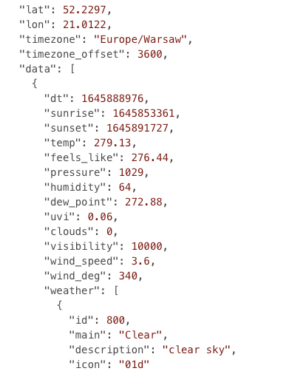

SAMPLE HISTORICAL API RESPONSE
SOURCED THE JSON RESPONSE USING OPEN WEATHER API to understand the available parameters
DUE TO API LIMITATION: WE decided to work on a sample of 2900 rows with ~950 rows per team member to work on and fetch the data using timestamp, pickup latitude and pickup longitude
Weather description
Weather icon
Weather id
Weather main
Wind degree
Wind speed
Data rain
Data snow
DATA RETRIEVED FOR EACH ROW FOR:
CLOUDS
Dew point
feels LIKE
Humidity
Pressure
Sunrise
Sunset
Temperature
Visibility

Slide 4
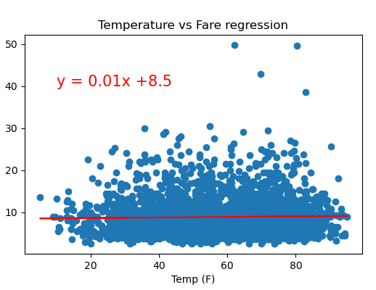
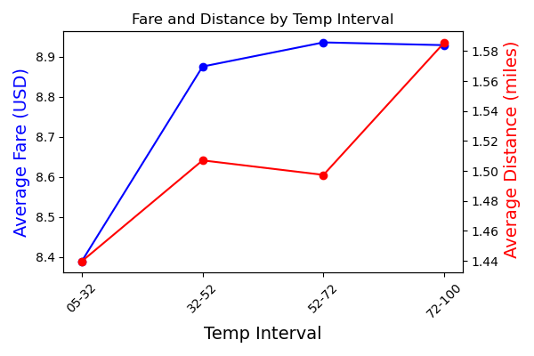

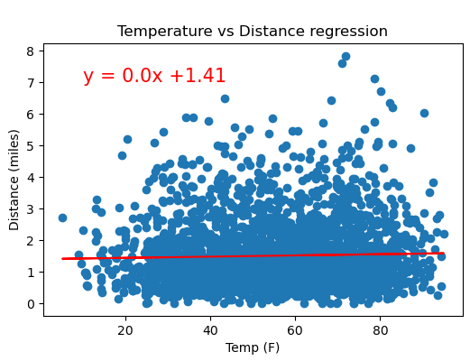
ANALYSIS – Effect of TEMPERATURE on uber bookings
Regression analysis shows no / weak correlation between temperature V/S fare and Distance
We decided to plot a dual axis chart to analyze the trend between fare and distance as per the created temperature intervals.
It seems like there is some trend between the first two intervals; however, we would like to deep dive and find if there is some correlation with the help of statistical tests.

Slide 5
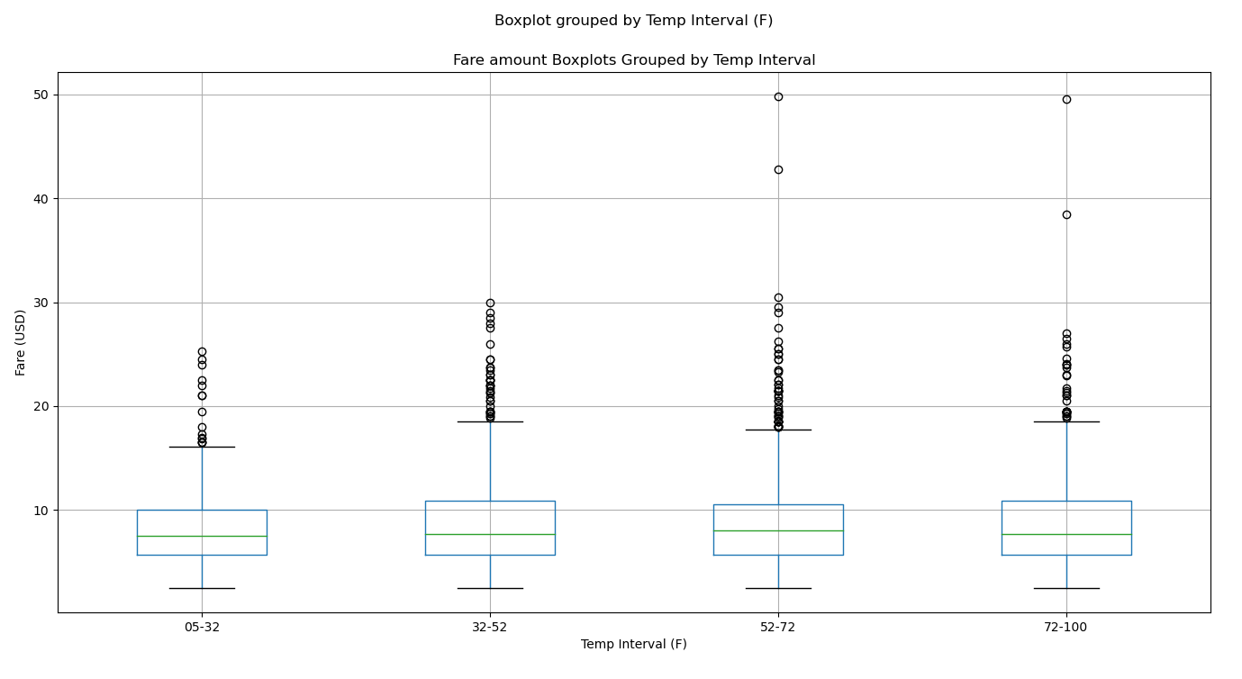
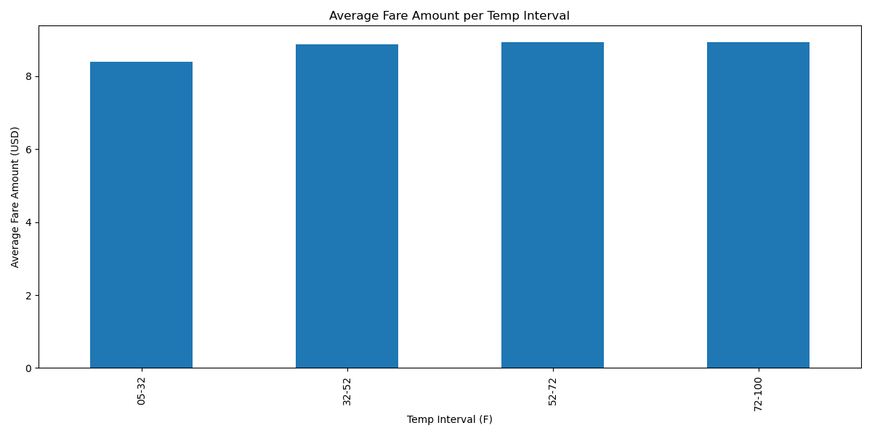
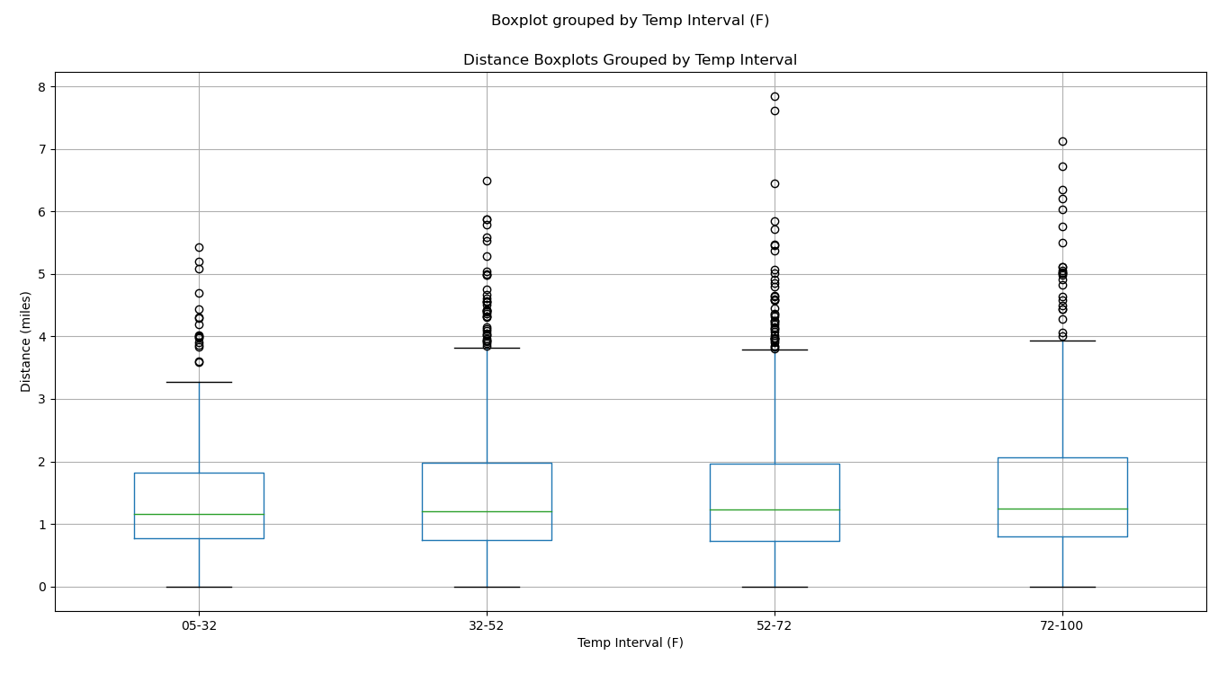
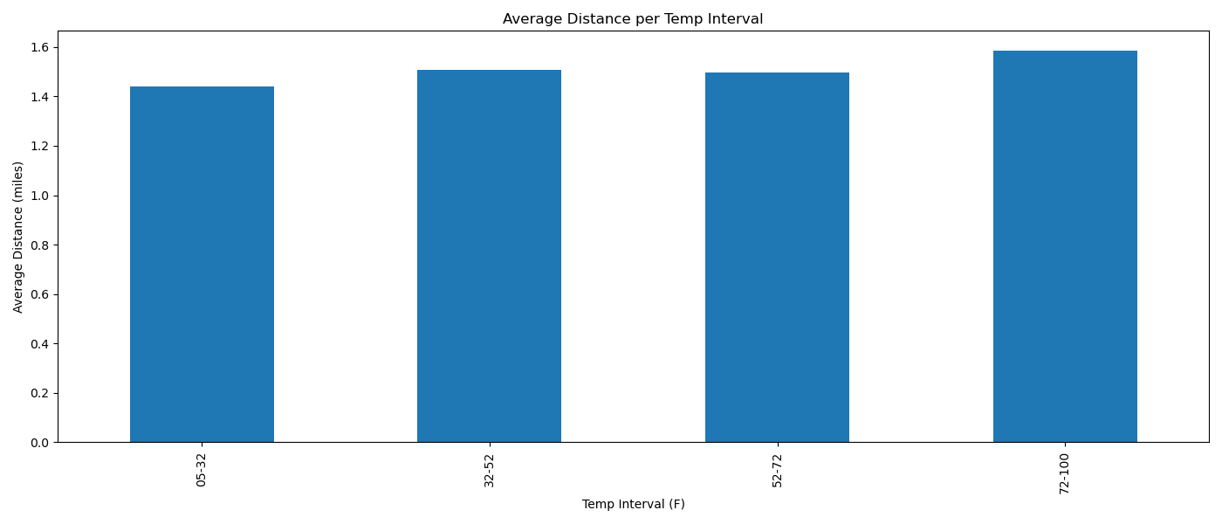
ANALYSIS – Effect of TEMPERATURE on uber bookings
NULL HYPOTHESIS
There is no significant effect of temperature on the fare and distance of uber
We performed anova test to compare the average fare and average distance across temperature intervals
P-value for AVERAGE FARE =0.313 P-value for AVERAGE DISTANCE =0.21
with the anova testS yielding a p-value> 0.05, we cannot reject the null hypothesis.
Temperature does not seem to have an effect on the FARE and distance of UBER trips

Slide 6
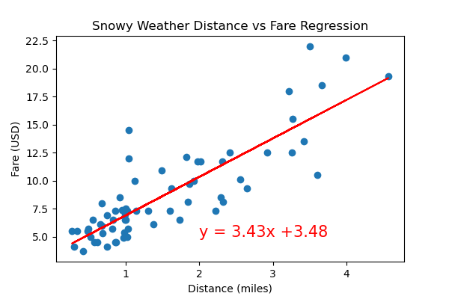
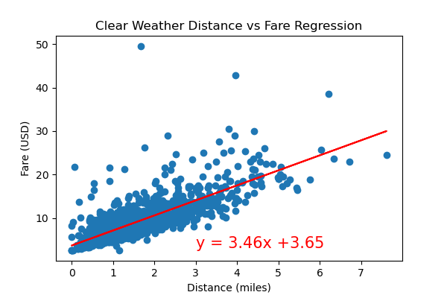
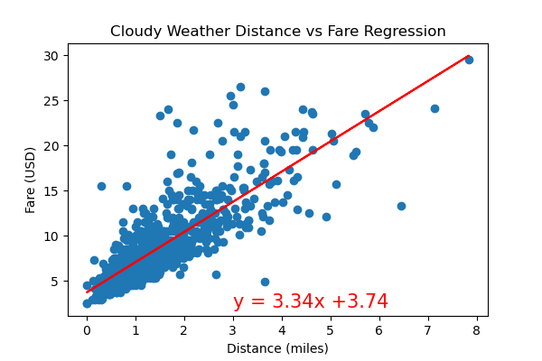
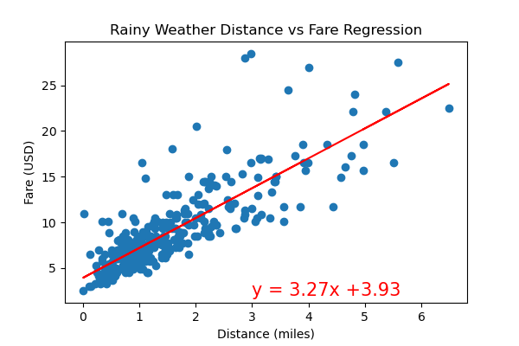

ANALYSIS – Effect of WEATHER on uber bookings
Regression plots show strong correlation between Trip Distance and fare as expected. The following are the r Values:
Clear weather: 0.78
Cloudy weather: 0.82
Snowy weather: 0.85
Rainy weather: 0.82
This suggests prices might be higher during Cloudy, Snowy and Rainy weather. Further statistical analysis follows

Slide 7
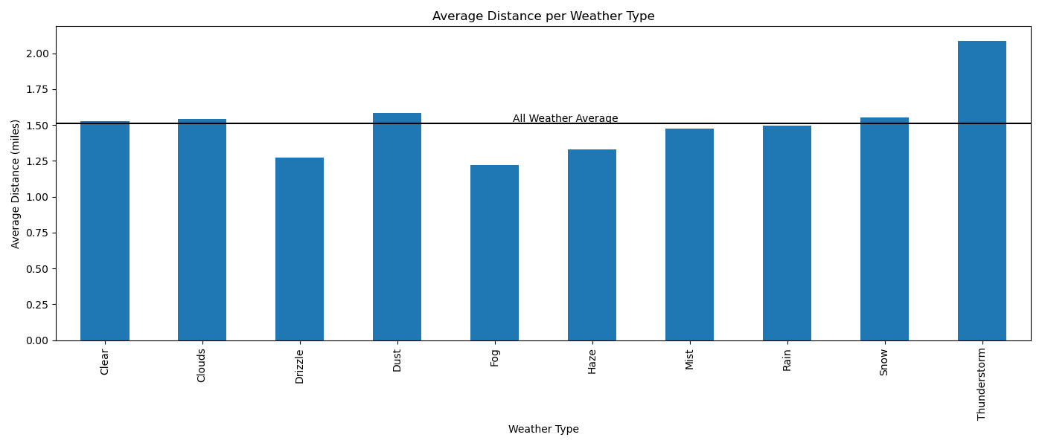
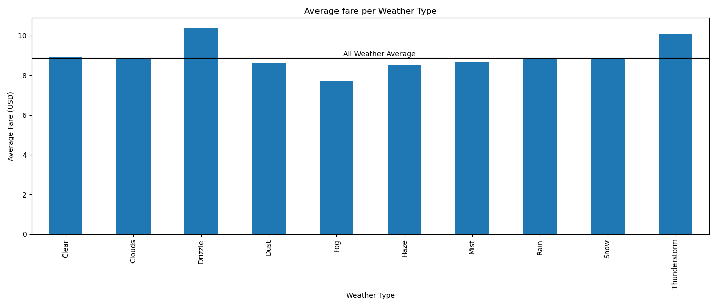
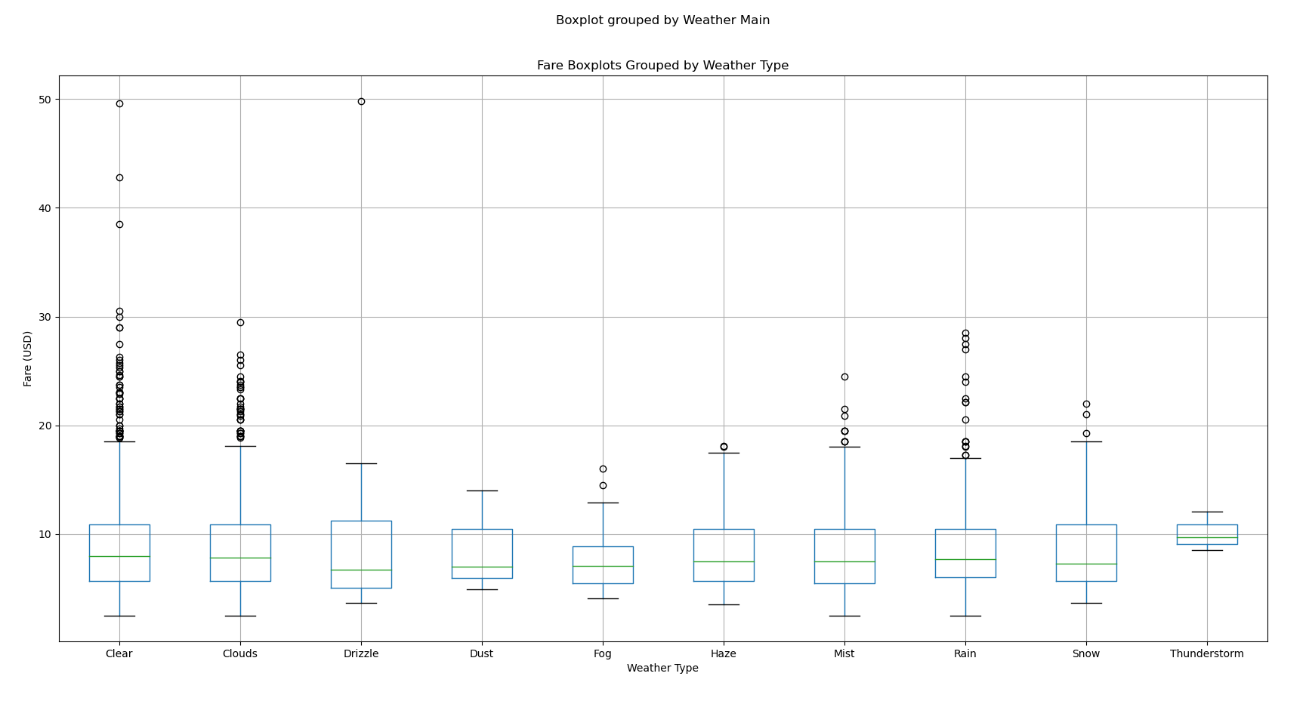
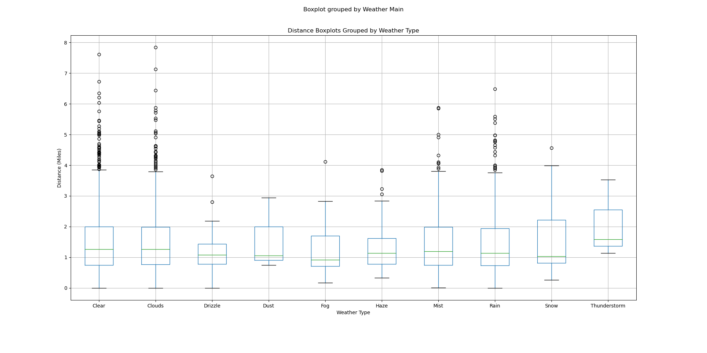
ANALYSIS – Effect of WEATHER on uber bookings
CONCLUSION: The anova tests returned p-Values greater than 0.05 for the different Groupings of weather types for both average fare and average trip distance.
We could not reject the null hypothesis/establish a firm link between weather type and fare amount or trip distance.
NULL HYPOTHESIS: There is no Statistically significant effect of Weather Type on Average Fare Amount and Average Trip Distance
We Carried out anova tests between the various weather types with regard to Average fare and average distance
P-Value for average fare: 0.92
P-Value for average distance: 0.92

Slide 8
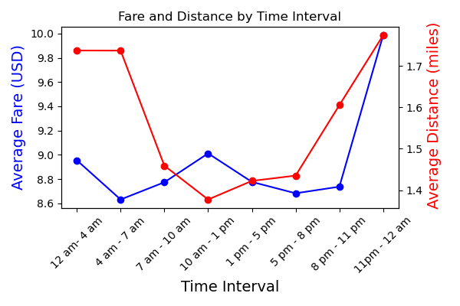
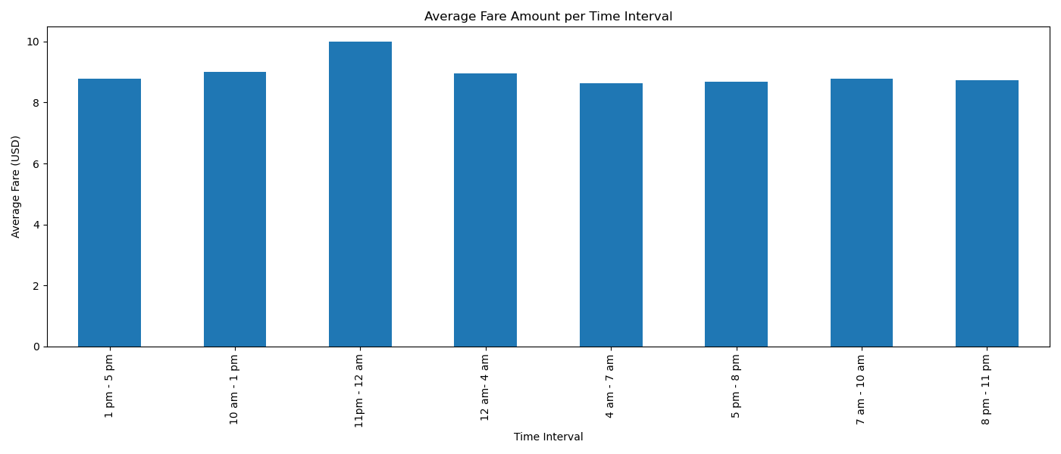

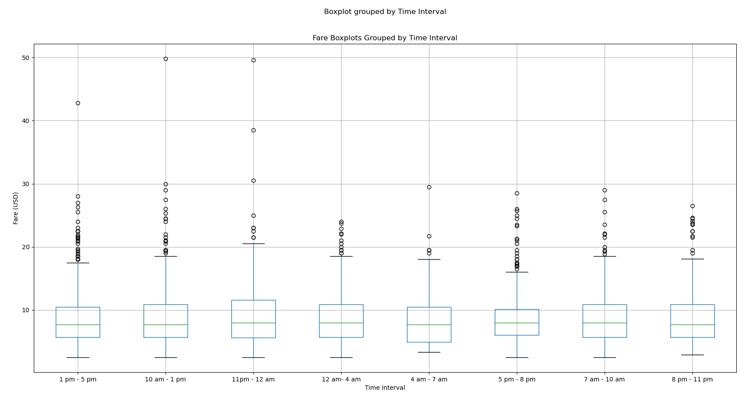
ANALYSIS – Effect of TIME on uber bookings
We decided to plot a dual axis chart to analyze the trend between fare and distance as per the Time intervals.
The Graph indicates that there is a trend between the two variables.
We have done statistical analysis between Fare and distance individually with time intervals, for different weather conditions to study if there is any relation among the variables.
Bar and box plots for fare amount per time
Summary statistics shows shows the means and medians are very close for all fare per time intervals

Slide 9
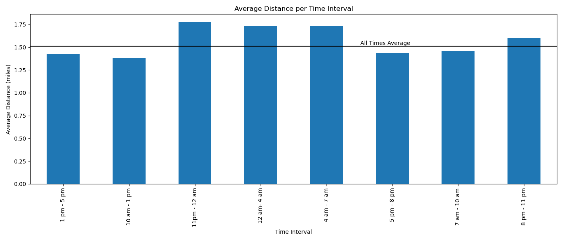
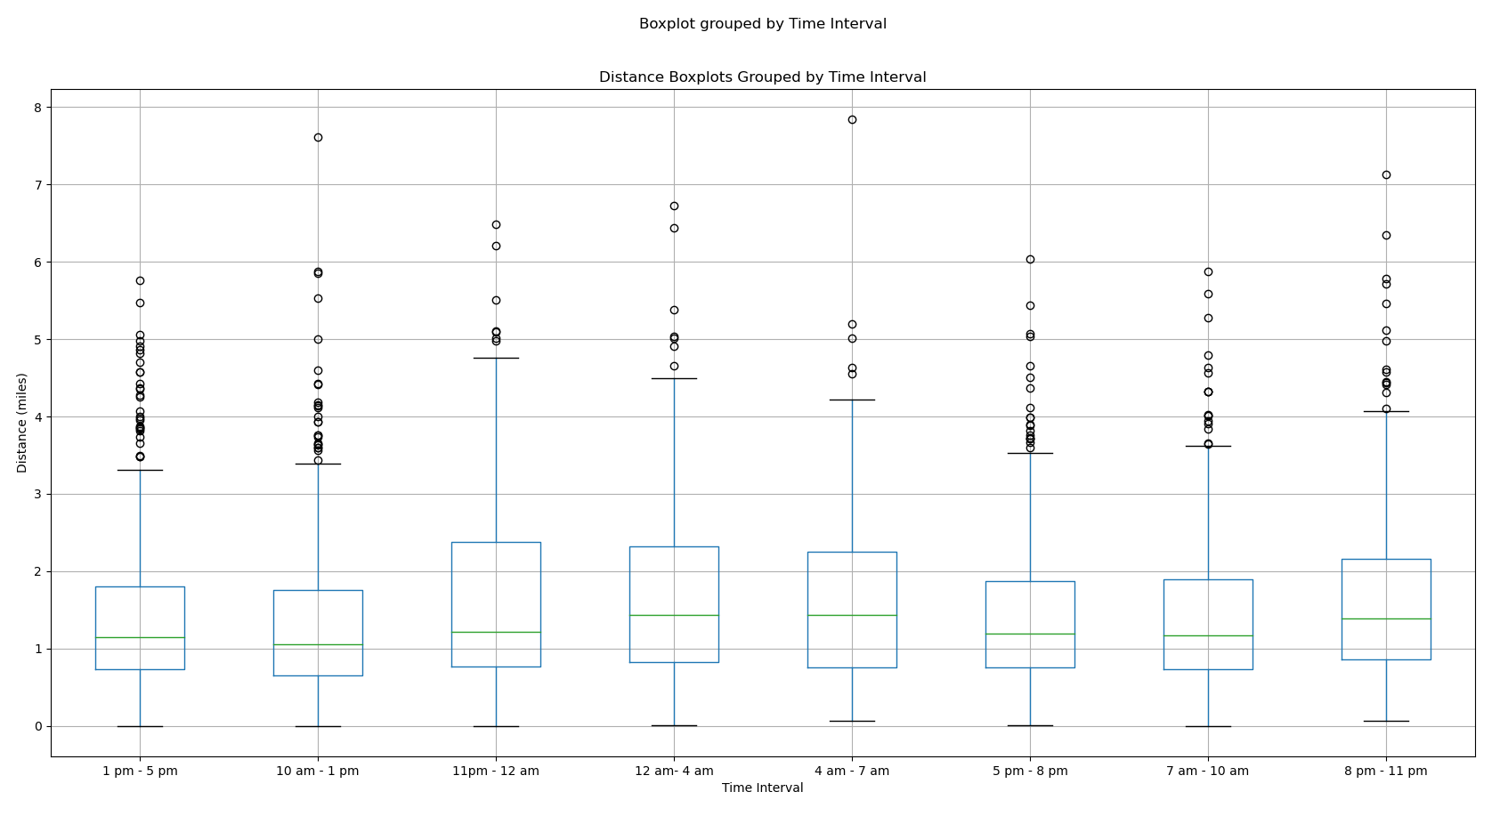

ANALYSIS – Effect of TIME on uber bookings
Null hypothesis: there is no statistically significant difference in fare amount or trip distance for different time intervals.
Conclusion Fare amount: Anova Test P-value: 0.12.since P-value is greater than 0.05, we were unable to reject the null hypothesis.
Conclusion trip distance: Anova Test P-value: 0.00000002<0.05, we reject the the null hypothesis. For further study, we carried out one sample T-test between different avg trip distance per time intervals against the population trip distance. most showed statistically significant difference except time groups 4am-7am, 7am-10am and 5pm-8pm
OVERALL Conclusion
We could not conclude that there is any effect of temperature or weather type on uber fare amount or uber trip distance.
However, there seem to be an effect on uber trip distance for certain time intervals.
LIMITATIONS
for more accurate results, we suggest to run this code oN A BIGGER SET OF DATA

Slide 10

FAHMIDA BILLA karan anand kevin mosweu
QUESTIONS are welcome

